Slide 1
INTRODUCTION TO THE GLOBAL ECO-INDUSTRIAL PARKS PROGRAMME (GEIPP)
Alessandro FLAMMINI, UNIDO Project Coordinator

Slide 2
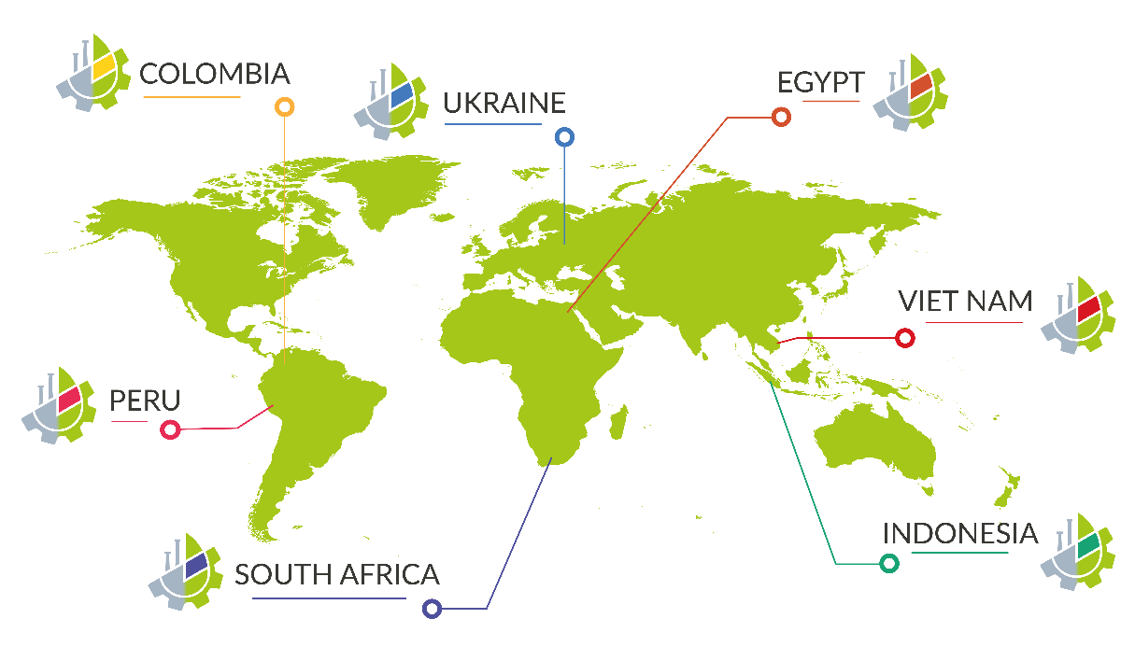
ABOUT GEIPP
The objective of the Global Eco-Industrial Parks Programme (GEIPP) is to demonstrate the viability and benefits of greening industrial parks by improving resource productivity and economic, environmental and social performances of businesses and thereby contributing to inclusive and sustainable industrial development in the participating developing and transition economies.

Slide 3
ABOUT GEIPP

Slide 4
DIFFERENT TERMINOLOGIES ARE USED
Combinations of related EIP terminology used internationally
Eco
Industrial
Park
Sustainable
Zone
Manufacturing
Low carbon
Area
Investment
Cluster
Green
(Special) Economic
Estate
Circular

Slide 5
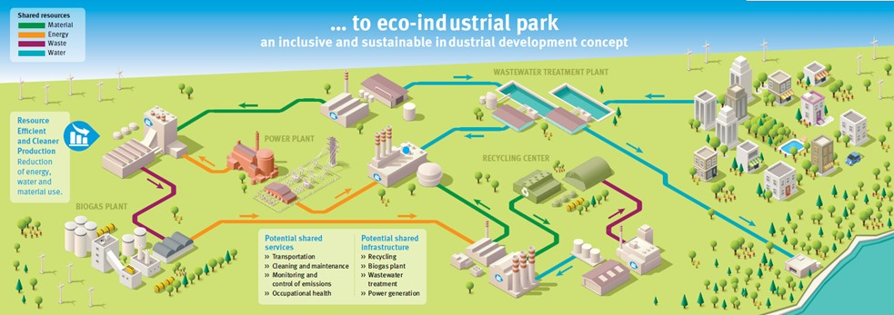
WHAT IS AN ECO-INDUSTRIAL PARK?
”A community of manufacturing and service businesses located together on common property. Member businesses seek enhanced environmental, economic, and social performance through collaboration in managing environmental and resource issues.
By working together, the community of businesses seeks a collective benefit that is greater than the sum of individual benefits each company would realize by only optimizing its individual performance.” (Lowe, 2001)
In short, the EIP concept is about creating more resource-efficient and cost-effective industrial parks
which are more competitive, attractive for investment and risk resilient.

Slide 6
Key benefits of eco-industrial parks
Reduce:
Use of materials, water, energy
Procurement costs
Waste
Greenhouse gases
Pollutants
Environmental, economic and social risks
Increase:
Competitiveness, profitability and foreign investment
Good-quality jobs
Workers health and safety
Quality of life for communities
Access to new technologies and finances
Resilience and business continuity
Beneficiaries
Environment
Park management and government
Local communities
Industries

Slide 7
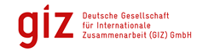
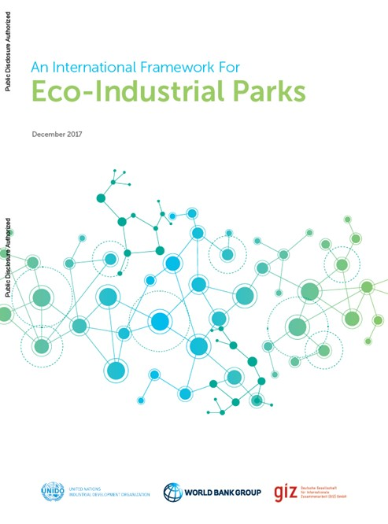
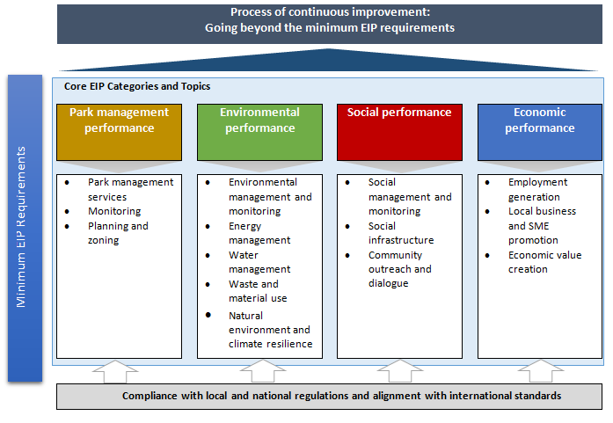
International Framework for Eco-Industrial Parks
UNIDO, World Bank Group, GIZ An International Framework for Eco-Industrial Parks
Version 2.0 (February 2021)
https://openknowledge.worldbank.org/handle/10986/35110

Slide 8
International Framework for Eco-Industrial Parks
Objectives
Park management
Park tenants (business)
Create common understanding of Eco-Industrial Parks
Identify improvement opportunities, optimise existing industrial parks
Monitor and assess operational performance of existing industrial parks
Inform investment decisions, funding and due diligence studies
Value recognition and build market profile
Serve as a practical framework to support decision making
Governments
Funding agencies

Slide 9
Insights from GEIPP analysis of Industrial Parks Performance

Slide 10
ASSESSING PARKS AGAINST THE EIP FRAMEWORK

Slide 11
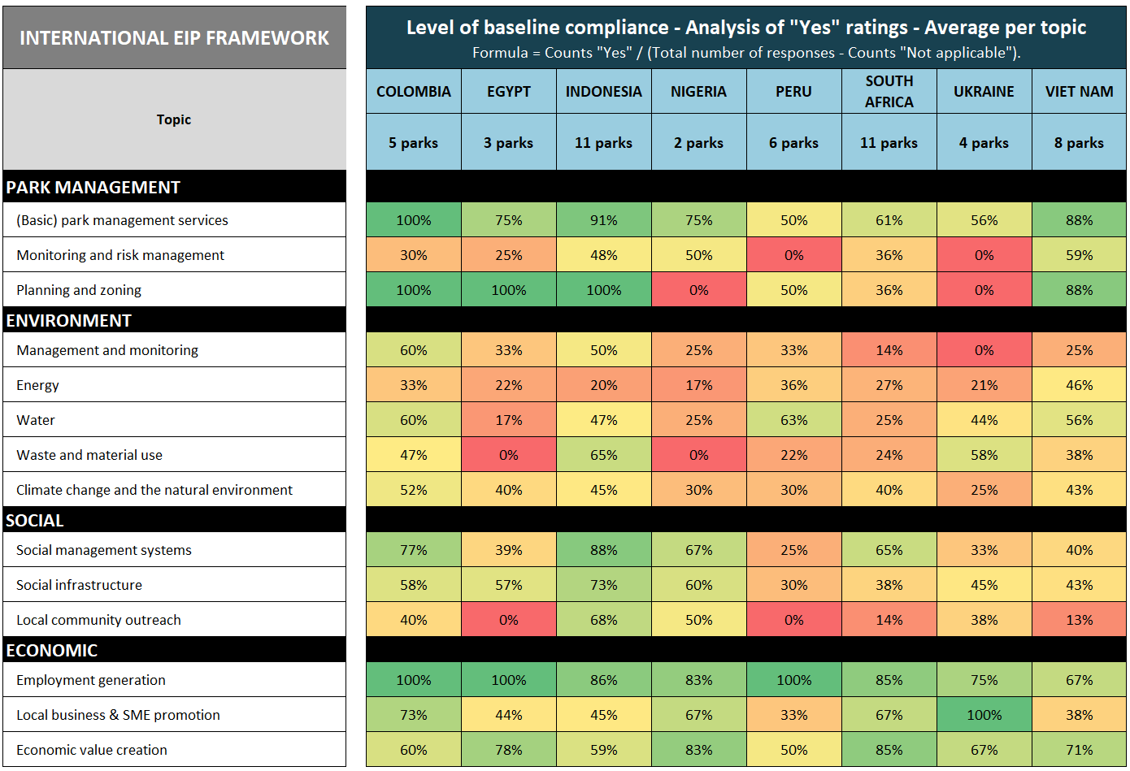
LESSONS LEARNT FROM EIP ASSESSMENTS
INSIGHTS FROM THE ASSESSMENT OF 50 INDUSTRIAL PARKS AGAINST 51 BENCHMARKS IN THE INTERNATIONAL EIP FRAMEWORK
Source: UNIDO (2020). Analysis of results from International EIP Framework assessments.

Slide 12
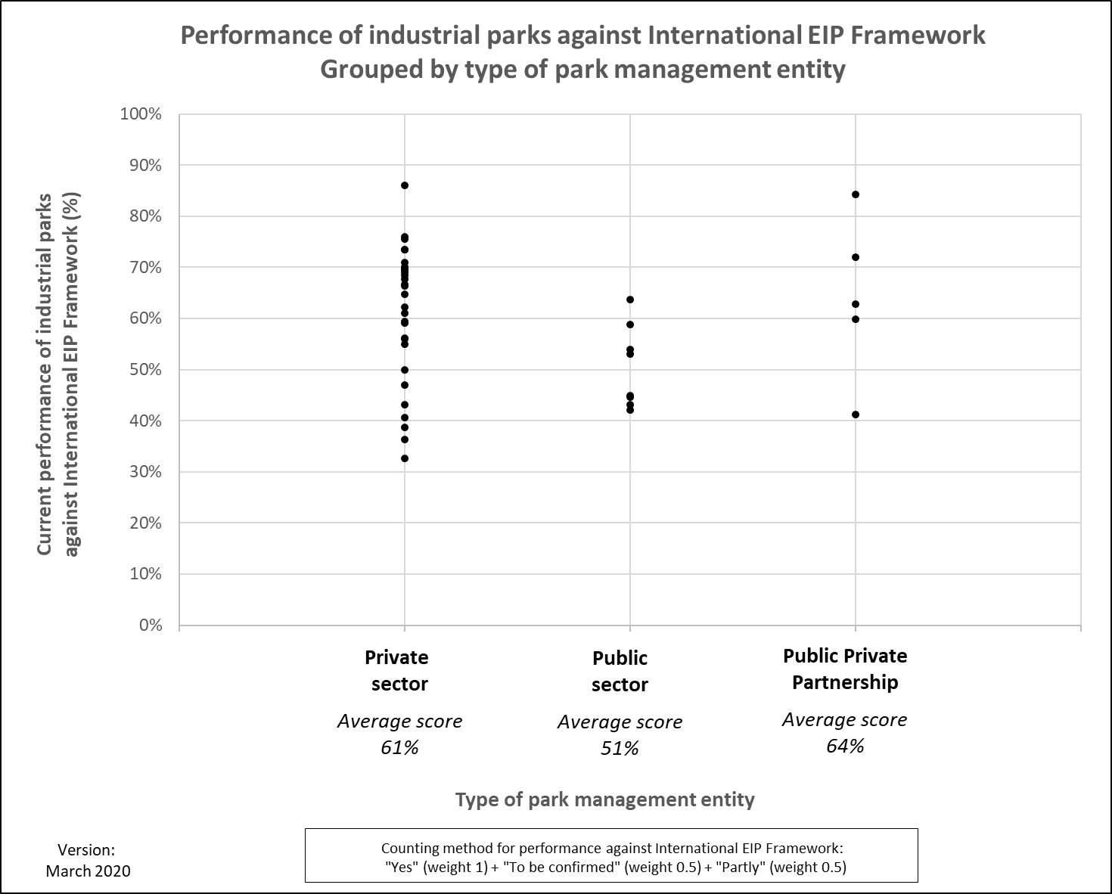
Link between Park Management Type and EIP Performance
Industrial parks managed by PPPs and private sectors have a higher average total EIP score than parks managed by public sector.
Each dot represents industrial park assessed to date by UNIDO against International EIP Framework.
KEY MESSAGE:
Whatever the park management type, industrial parks should be “run like a business”
Source: UNIDO (2020). Analysis of results from International EIP Framework assessments.

Slide 13
GEIPP Programme Country-level Interventions

Slide 14
KEY COMPONENTS OF EIPs
Top-down approaches: Governmental agencies as entry-point
Park management services and governance
Resource efficient and cleaner production
Industrial and infrastructure synergies
Healthy and integrated work force, industry urban synergies
Spatial planning and zoning
Bottom-up approaches: Industrial parks as entry-point

Slide 15
UNIDO Support for EIP Transformation
SCOPE INTERVENTIONS to identify and prioritize EIP activities, which are most suitable and most effective for further stakeholder consideration.
AWARENESS RAISING of the benefits and added value of EIPs as well as associated implementation processes amongst key private and public stakeholder groups.
PROVIDE POLICY SUPPORT for translation of EIP concepts and associated practices into national policies and government decision-making processes; an enabling policy environment is crucial to ensure the successful development, implementation and perpetuation of EIP practices.
DEVELOPMENT AND ADVICE ON PARK MANAGEMENT STRUCTURES to take care of a range of topics required to develop and operate an industrial park sustainably, to attract investments and to provide attractive working conditions; the formalization and sound functioning of a park management structure is a key prerequisite for an EIP.

Slide 16
UNIDO Support for EIP Transformation
PROVIDE TECHNICAL SUPPORT to upscale resource efficiency and industrial synergies/symbiosis; RECP and industrial synergies increase efficiency and reduce risks to humans and the environment, both at the company and park levels; industrial synergies can be for instance shared infrastructures, services and utilities, or by-product and waste exchanges between companies.
UNDERTAKING PERFORMANCE MONITORING AND BENCHMARKING to track progress of EIPs against set objectives and thus demonstrate environmental, economic and social outcomes in an efficient, transparent and accountable manner.
CAPACITY-BUILDING of key stakeholders throughout the entire development of EIPs (technical and non-technical capacities).

Slide 17
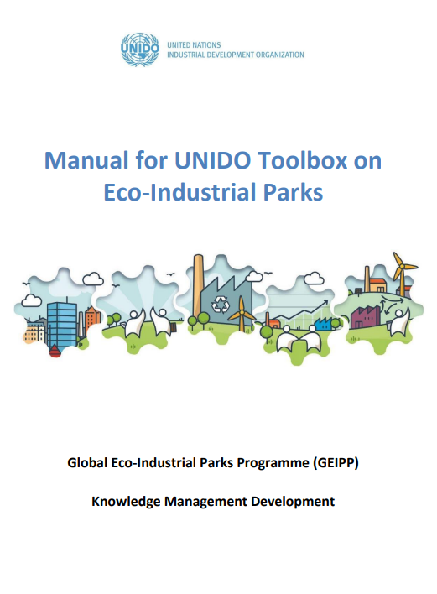
UNIDO EIP Toolbox
EIP Policy
Park assessment
EIP Implementation
EIP Selection Tool
EIP Assessment Tool
RECP Monitoring Tool
Stakeholder Mapping Tool
Industrial Symbiosis Identification Tool
EIP Monitoring Tool
EIP Policy Support Tool
EIP Concept Planning Tool
EIP Management Services Tool
EIP Master Plan Sustainability Review Tool
EIP Access2Finance Tool
UNIDO EIP Tools are available at:
https://hub.unido.org/eco-industrial-parks

Slide 18
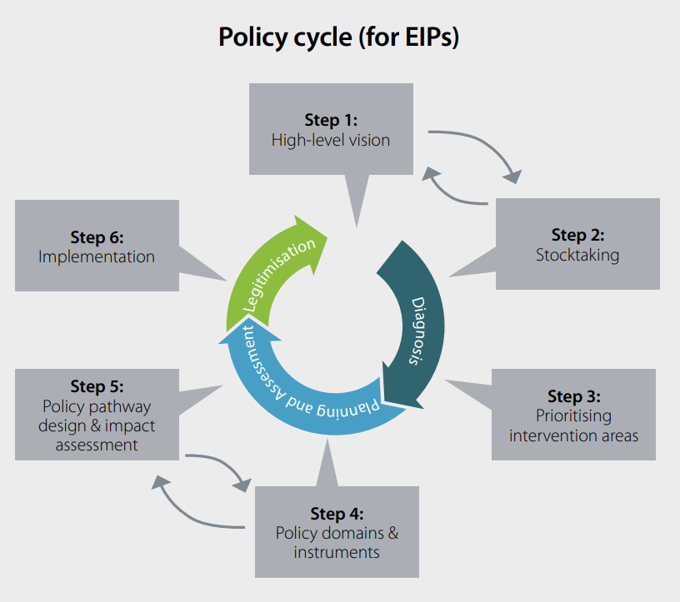
PILLAR I: Mainstreaming EIPs in Relevant Policy Regulations
Increased role for EIP in environmental, industry and other relevant policies
National EIP replication strategies (including technical and financial facilitation
Integration of EIP into circular economy-related policies
UNIDO EIP Policy Support Tool: assists EIP policy planning and development by supporting the analysis of stakeholders, creating an overview of existing policies and governance structures relevant to EIPs, prioritizing EIP policy interventions, developing a policy vision/goal.

Slide 19
SOUTH AFRICA EIP POLICY CASE STUDY
Stakeholders Mapping
Policy Gap Analysis
2020
done
EIP perspective included to Governmantal Economy Strategy 2030
Official Interdepartmental Working Group on EIP policy established
Road Map on EIP policy implementation
2021
done
International proposals to EIP Policy Vision and Roadmap
EIP Incentives Report
EIP perspective included to draft IP Strategy 2030
Strategic Ecology Assessment of IP Strategy with EIP perspective
Forecast of EIP policy development (Regulatory Impact Assessment)
Draft EIP Law (amendments to IP Law and other Laws)
2022
done
2022
plan
National Survey on Market Readiness to EIP model
Online EIP training course for decision-makers and practitioners
EIP Supply Chains Disruption Report
Adoption of EIP Law
Adoption of sub-laws on EIP (criteria, verification, monitoring)
Bringing policies in compliance to EIP International Framework
2023
plan

Slide 20
The Significance of the Park Management Entity
Park Management plays a critical role as the entry point and driver to achieve EIP objectives
They connect the Park, Resident Firms, relevant Government Agencies and the wider community.
SUCCESS FACTORS FOR EIP MANAGEMENT | COMMON CHALLENGES FOR EIP MANAGEMENT
Strong leadership and commitment | Trade-off logic: Industrial development vs. environment
Proactive marketing of EIP features and benefits | Insufficient inclusion of social dimensions
Proactive facilitation of stakeholder processes | Insufficient priority on shared and integrated infrastructure
Effective model to share and recover park level costs/benefits | Lack of understanding that environmental/social risks are economic risks
Creation of feasible and valuable infrastructure services

Slide 21
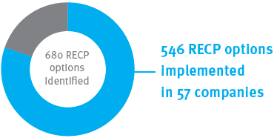
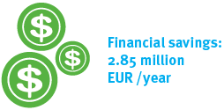
Firm-level RECP IN VIET NAM (2017-2019)
COMPANY INVESTMENT
TRIGGERED: EUR 9 Mio

Slide 22
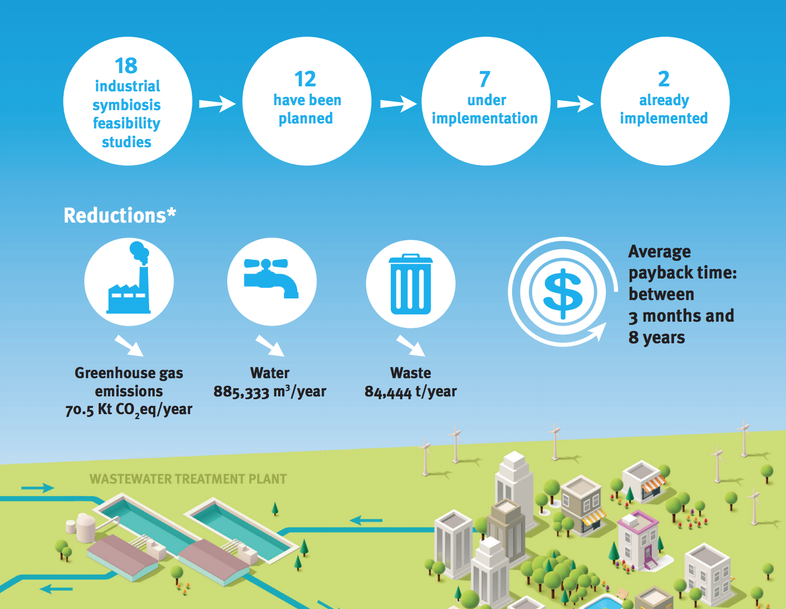
Industrial Symbiosis in Can Tho and Da Nang IPs (2018-2019)

Slide 23
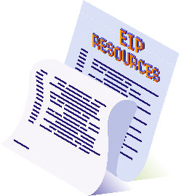
UNIDO EIP ONLINE COURSE
FORMAT: Online
LENGTH: 6-7 Hours
LANGUAGE: English
CERTIFICATE: Yes
ACCESS TO THE UNIDO EIP TOOLBOX
To assist with the development and implementation of EIPs and related initiatives
COURSE SNAPSHOT
7 SELF-PACED INTERACTIVE MODULES
Introduction to EIPs
EIP Opportunity Assessment
EIP Management
Resource Efficient and Cleaner Production
Industrial Synergies
EIP Concept Planning
Implementation of EIP Opportunities
FURTHER CURATED RESOURCES ON EIPS
Key resources and handbooks related to the implementation of EIPs including the International Framework for Eco-Industrial Parks (UNIDO, GIZ and WBG)
LINK TO REGISTER: https://hub.unido.org/training-modules-eco-Industrial-parks

Slide 24
FOR MORE INFORMATION ON EIPS, VISIT THE UNIDO KNOWLEDGE HUB (HUB.UNIDO.ORG)

